Slide 1
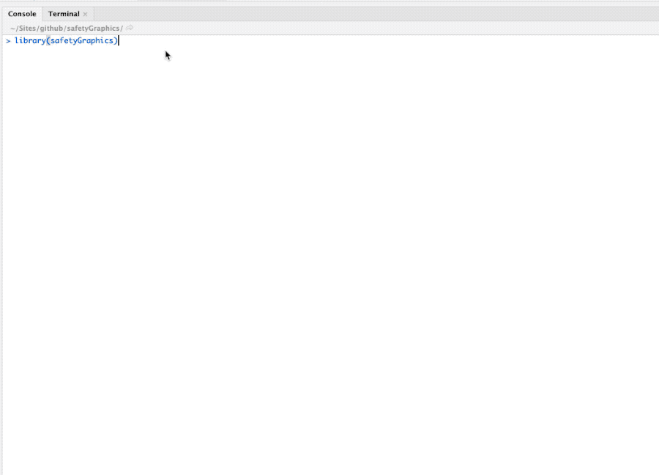
Modernizing the Clinical Trial Analysis Pipeline with R and JavaScript
Jeremy Wildfire, Rebecca Krouse‎, Preston Burns, Ryan Bailey‎, Spencer Childress‎, Susan Duke, James Buchanan, Xiao Ni, ‎Frank Harrell
Problems
Clinical trial research is highly regulated and notoriously slow moving.
Manual review of huge data listings is still common.
Existing analysis tools are expensive, difficult to customize and tend to use proprietary formats, limiting reproducibility.
Solutions: Create interactive tools that are
Open Source - Transparent. Customizable. Free!
Interactive - Users can explore their data.
Easy to Use - Just open up a webpage.
Easy to Configure - Streamlined configuration with R.
Compliant with Data Standards - Support ADaM and SDTM by default.
Highly Collaborative - Clinicians and Programmers working together.
Agile - Frequent releases with GitHub.
Engaging - Regular Feedback from users. Pilot testing. Open issue tracking.
Packages: safetygraphics | datadigest
Description: Evaluation of clinical trial safety in R
Links: GitHub | Interactive Chart | Shiny
Related Tools: SafetyExploreR | safety-eDish
Acknowledgements
The safetyGraphics and safety-edish projects are maintained by the ASA Biopharm/DIA Safety Working Group’s Interactive Safety Graphics Taskforce, which combines stakeholders from across the pharmaceutical industry, including the FDA. All other work done by The Center for Interactive Data Visualization at Rho. All work is free and open source with an MIT License. Author Affiliations are as follows with an “*” indicating Safety Graphics Taskforce members: J Wildfire (Rho*), Rebecca Krouse (Rho*), Preston Burns (Rho), Ryan Bailey (Rho), Spencer Childress (Rho), Susan Duke (FDA*), James Bucanan (Covilance*), Xiao Ni (Novartis*), Frank Harrell (Vanderbilt*)
#Code to initialize shiny application with sample data
devtools::install_github("ASA-DIA-InteractiveSafetyGraphics/safetyGraphics")
library("safetyGraphics")
safetyGraphicsApp()

Slide 2

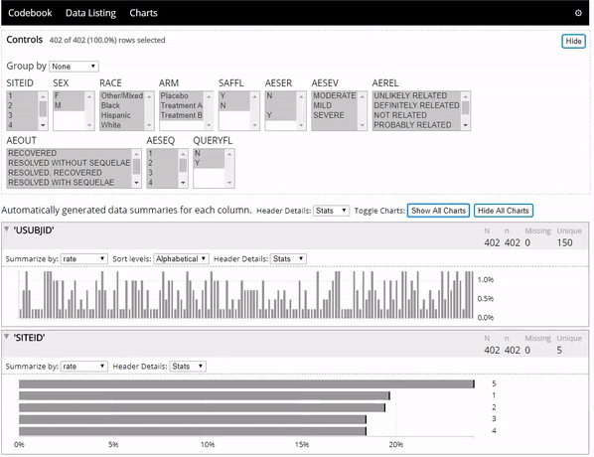
Modernizing the Clinical Trial Analysis Pipeline with R and JavaScript
Jeremy Wildfire, Rebecca Krouse‎, Preston Burns, Ryan Bailey‎, Spencer Childress‎, Susan Duke, James Buchanan, Xiao Ni, ‎Frank Harrell
Problems
Clinical trial research is highly regulated and notoriously slow moving.
Manual review of huge data listings is still common.
Existing analysis tools are expensive, difficult to customize and tend to use proprietary formats, limiting reproducibility.
Solutions: Create interactive tools that are
Open Source - Transparent. Customizable. Free!
Interactive - Users can explore their data.
Easy to Use - Just open up a webpage.
Easy to Configure - Streamlined configuration with R.
Compliant with Data Standards - Support ADaM and SDTM by default.
Highly Collaborative - Clinicians and Programmers working together.
Agile - Frequent releases with GitHub.
Engaging - Regular Feedback from users. Pilot testing. Open issue tracking.
Packages: safetygraphics | datadigest
Description: Concise interactive data summaries in R
Links: CRAN | GitHub | Interactive Chart
Related Tools: web-codebook
datadigest
Acknowledgements
The safetyGraphics and safety-edish projects are maintained by the ASA Biopharm/DIA Safety Working Group’s Interactive Safety Graphics Taskforce, which combines stakeholders from across the pharmaceutical industry, including the FDA. All other work done by The Center for Interactive Data Visualization at Rho. All work is free and open source with an MIT License. Author Affiliations are as follows with an “*” indicating Safety Graphics Taskforce members: J Wildfire (Rho*), Rebecca Krouse (Rho*), Preston Burns (Rho), Ryan Bailey (Rho), Spencer Childress (Rho), Susan Duke (FDA*), James Bucanan (Covilance*), Xiao Ni (Novartis*), Frank Harrell (Vanderbilt*)
#Code to initialize widget using demo data sets
install.packages("datadigest")
library("datadigest")
explorer(demo = TRUE)

Slide 3
Modernizing the Clinical Trial Analysis Pipeline with R and JavaScript
Jeremy Wildfire, Rebecca Krouse‎, Preston Burns, Ryan Bailey‎, Spencer Childress‎, Susan Duke, James Buchanan, Xiao Ni, ‎Frank Harrell
Problems
Clinical trial research is highly regulated and notoriously slow moving.
Manual review of huge data listings is still common.
Existing analysis tools are expensive, difficult to customize and tend to use proprietary formats, limiting reproducibility.
Solutions: Create interactive tools that are
Open Source - Transparent. Customizable. Free!
Interactive - Users can explore their data.
Easy to Use - Just open up a webpage.
Easy to Configure - Streamlined configuration with R.
Compliant with Data Standards - Support ADaM and SDTM by default.
Highly Collaborative - Clinicians and Programmers working together.
Agile - Frequent releases with GitHub.
Engaging - Regular Feedback from users. Pilot testing. Open issue tracking.
Technical Framework: R infrastructure + javascript graphics
safetyGraphics package
safetyGraphicsApp (Shiny Application)
Charting Module(s)
Data Loading Module
htmlwidget
Setting Configuration Module
Interactive Graphics
(javascript)
Export Reproducible Report
D3.js
webcharts.js
Automated tests (shinytest + travis) coming soon
Standalone Helper Functions
Automatically detect data standard
Automatically generate chart settings
Automatically check for common errors (e.g. strings in numeric column 😠 )
250+ automated tests (testthat + travis)
Acknowledgements
The safetyGraphics and safety-edish projects are maintained by the ASA Biopharm/DIA Safety Working Group’s Interactive Safety Graphics Taskforce, which combines stakeholders from across the pharmaceutical industry, including the FDA. All other work done by The Center for Interactive Data Visualization at Rho. All work is free and open source with an MIT License. Author Affiliations are as follows with an “*” indicating Safety Graphics Taskforce members: J Wildfire (Rho*), Rebecca Krouse (Rho*), Preston Burns (Rho), Ryan Bailey (Rho), Spencer Childress (Rho), Susan Duke (FDA*), James Bucanan (Covilance*), Xiao Ni (Novartis*), Frank Harrell (Vanderbilt*)

Slide 4
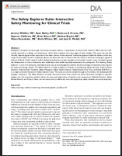
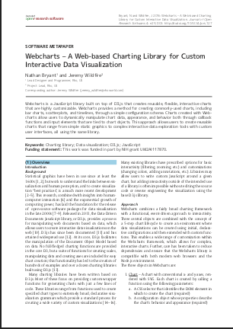
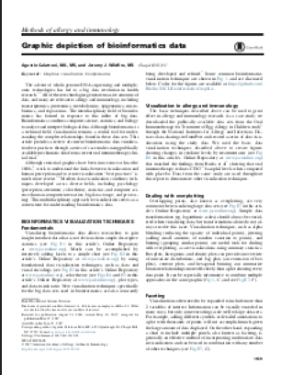
Modernizing the Clinical Trial Analysis Pipeline with R and JavaScript
Jeremy Wildfire, Rebecca Krouse‎, Preston Burns, Ryan Bailey‎, Spencer Childress‎, Susan Duke, James Buchanan, Xiao Ni, ‎Frank Harrell
Problems
Clinical trial research is highly regulated and notoriously slow moving.
Manual review of huge data listings is still common.
Existing analysis tools are expensive, difficult to customize and tend to use proprietary formats, limiting reproducibility.
Solutions: Create interactive tools that are
Open Source - Transparent. Customizable. Free!
Interactive - Users can explore their data.
Easy to Use - Just open up a webpage.
Easy to Configure - Streamlined configuration with R.
Compliant with Data Standards - Support ADaM and SDTM by default.
Highly Collaborative - Clinicians and Programmers working together.
Agile - Frequent releases with GitHub.
Engaging - Regular Feedback from users. Pilot testing. Open issue tracking.
Relevant Papers
Wildfire, Jeremy, et al. "The Safety Explorer Suite: Interactive Safety Monitoring for Clinical Trials." Therapeutic innovation & regulatory science (2018): 2168479018754846.
Bryant, Nathan, and Jeremy Wildfire. "Webcharts–A Web-based Charting Library for Custom Interactive Data Visualization." Journal of Open Research Software 4.1 (2016).
Calatroni, Agustin, and Jeremy Wildfire. "Graphic depiction of bioinformatics data." Journal of Allergy and Clinical Immunology 140.6 (2017): 1519-1522.
And more …
Graphics for Monitoring Clinical Trial Operations
crf-heatmap: Visualize the level of completeness of a clinical database
query-overview: Bar Chart showing the distribution of queries in a clinical trial
participant-visit-listing: Visualize visit completion for each participant in a clinical trial
An unrelated, but super useful, R Package
CRANsearcher - RStudio add-in to search CRAN packages titles and descriptions.
Acknowledgements
The safetyGraphics and safety-edish projects are maintained by the ASA Biopharm/DIA Safety Working Group’s Interactive Safety Graphics Taskforce, which combines stakeholders from across the pharmaceutical industry, including the FDA. All other work done by The Center for Interactive Data Visualization at Rho. All work is free and open source with an MIT License. Author Affiliations are as follows with an “*” indicating Safety Graphics Taskforce members: J Wildfire (Rho*), Rebecca Krouse (Rho*), Preston Burns (Rho), Ryan Bailey (Rho), Spencer Childress (Rho), Susan Duke (FDA*), James Bucanan (Covilance*), Xiao Ni (Novartis*), Frank Harrell (Vanderbilt*)
Contact Info: @jwildfire or jeremy_wildfire@rhoworld.com

